Slide 1

Team 8: Analysing the content of README files on the GitHub
Presented by: Hangyue Xu and I-Sheng Chris Wang
Supervisor: Christoph Treude
9th June 2017
Notes:
Good morning everyone, my name is Chris and my project mate is Hangyue. We are from team 8 which the project title is analysing the content of README files on the GitHub. Before we enter to the main content, we would like to recall what exactly is our project doing and what are the goals that we are going to achieve in order to be a success.

Slide 2
What is our project doing?
Develops a web application
Analyses the README files
Aggregate the result of analysis
Notes:
As we mentioned earlier in our business plan, the purpose of this project is involving the development of the web application that can randomly select the several GitHub projects and then analyse different kinds of the content of README files on the GitHub.

Slide 3

Process flow of our proposed system
Web application
Notes:
I would like to talk about the process flow diagram and the logic behind on how our system works. As we can see, the user can access to our web application through the specific domain we provided. It can be considered as an one-press key, like the users entered an integer value and then click the submit button, then our proposed system will start processing and produce the result at the end.

Slide 4

Process flow of our proposed system
It will link to GitHub API after users clicked the submit button
Links
GitHub
Web application
Notes:
So after the users have clicked the submit button, the first step is the system will link to the GitHub API.

Slide 5
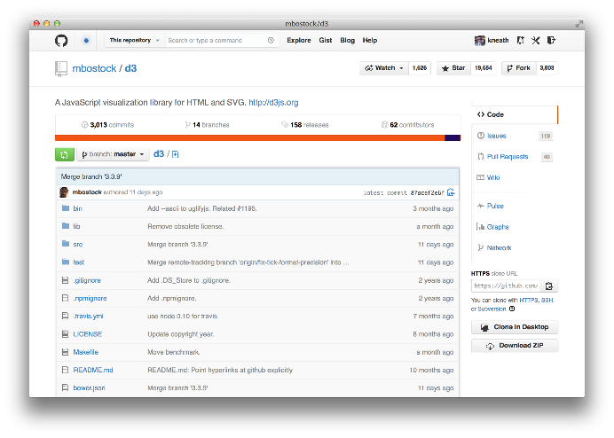
Process flow of our proposed system
Randomly selects the GitHub projects by using its unique ID
Links
GitHub Projects
GitHub
Randomly selects
Web application
Notes:
After linked, the second step is randomly selects the GitHub project by using its unique ID. Because each project will have a unique ID to differentiate.

Slide 6

Process flow of our proposed system
Fetches the README and perform analysis
Fetches
Links
README
GitHub Projects
GitHub
Randomly selects
Web application
Notes:
After selected the corresponding GitHub projects, the third step is fetching the README file, then start analysing the content of README.

Slide 7
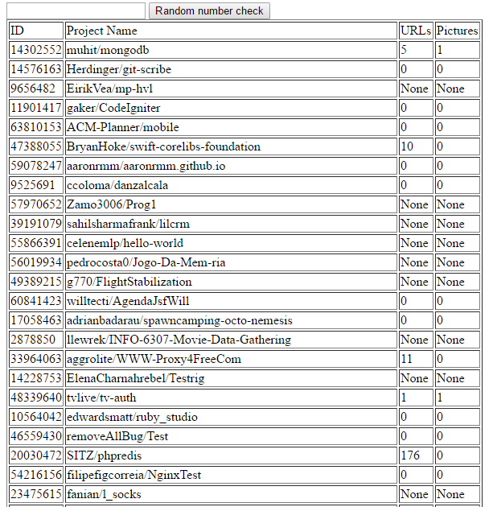
Process flow of our proposed system
Fetches
Links
Results
README
GitHub Projects
Extracts & Aggregates
GitHub
Extracts relevant information and aggregates in the form of summary
Randomly selects
Web application
Notes:
And from the README file, it will extract the relevant information that required by our supervisor. Then after finished extracting, the system will then aggregate all the extracted information in the form of summary.

Slide 8
Process flow of our proposed system
Fetches
Links
Results
README
GitHub Projects
Extracts & Aggregates
GitHub
Randomly selects
Web application
Notes:
So this is what basically our overall process flow of our proposed system.

Slide 9
Outline
What is our project goals?
What were our main requirements?
What was achieved in our project?
What were our additional requirements?
How we build our proposed system?
What software tools we have chosen? Why?
What have we learned in this project?
Future Development
Notes:
These are the outline that we are going to present one-by-one.

Slide 10
What is our project goals?
Develops a web application that can systematically analyse the content of GitHub README files.
Collect
Relate
Cleanse
Classify
Report and Analyse
Notes:
As mentioned earlier, our project goal of this project is developing a web application and systematically analyse the content of GitHub README files.

Slide 11
What is our project goals?
A guideline for the new users who intend to write the README file at their first time.
New users can gain some idea from the aggregated form of summary.
Notes:
Moreover, our project is meant to do for those users who intended to write a README file at the first time. With the aggregated form of the summary on the web application, it can act as the template as well as the new user will get to know what is their expectation of creating a new README file.

Slide 12
What were our main requirements?
Extracting the clickable URLs
Hangyue Xu
Extracting the empty README
Extracting the section headings
I-Sheng Chris Wang
Aggregate all the results
Notes:
Here are the main requirements we have gathered in the beginning of this project. For myself, I was handling the URLs that can be extracted from the selected README files, as our project is only fetch certain formats which is README.md, so our systems will be automatically ignore all other kind of formats of README files such as README.markdown, README.txt, etc. The second function that I was handling is listing all the projects that is no README file as well as those README others than README.md.
For my project mate, he was handling the section heading that can be extracted from the selected README files. Moreover, he will be mainly in-charge the user interface design and aggregating the result of section heading, URLs and empty files.

Slide 13
What was achieved in our project?
Notes:
What was achieved in our project? Theoretically, we have achieved all the requirements that we gathered from the early beginning.

Slide 14
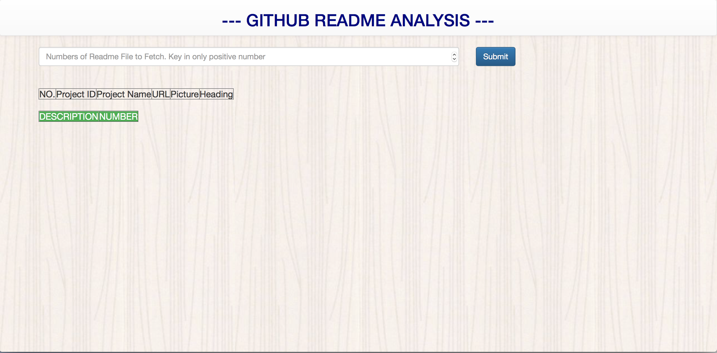
What was achieved in our project?
Our main user interface design of the system
Notes:
This is our main user interface design of our project. This text field allow user to key in positive value.

Slide 15
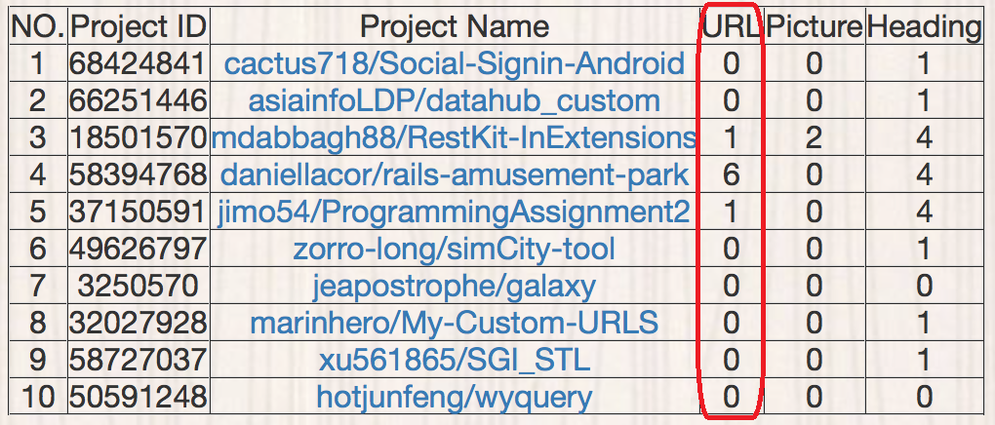
What was achieved in our project?
Extracted the clickable URLs
Notes:
This is after the users has clicked the submit button. This column is the clickable URLs that has been extracted from the README.

Slide 16
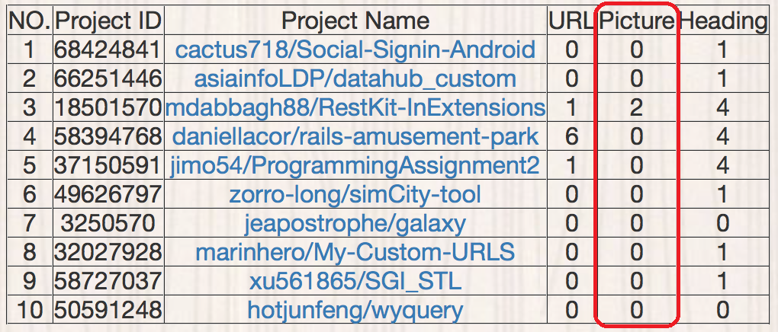
What was achieved in our project?
Extracted the clickable images
Notes:
This column is the clickable images that has been extracted from the README.

Slide 17
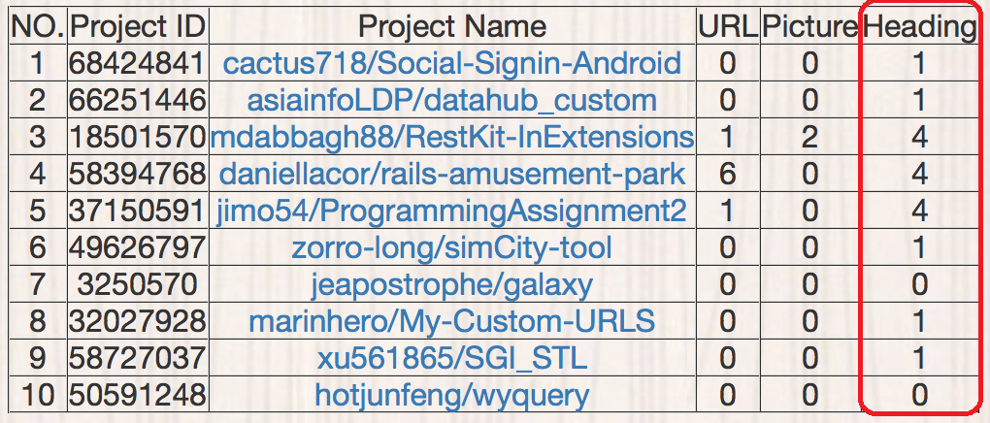
What was achieved in our project?
Extracted the section headings
Notes:
This column is the section heading that has been extracted from the README

Slide 18
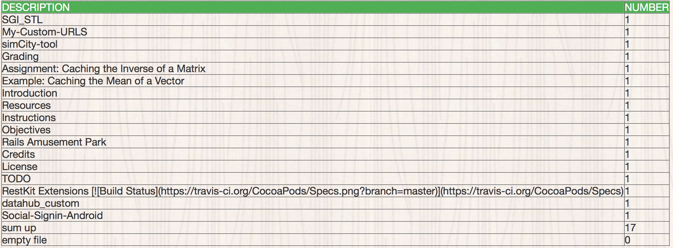
What was achieved in our project?
Aggregated results of section heading and sum of the empty README
Notes:
This is the aggregated results of section heading and sum of the empty README. 0 means there is no empty files while extracting the README from the GitHub project.

Slide 19
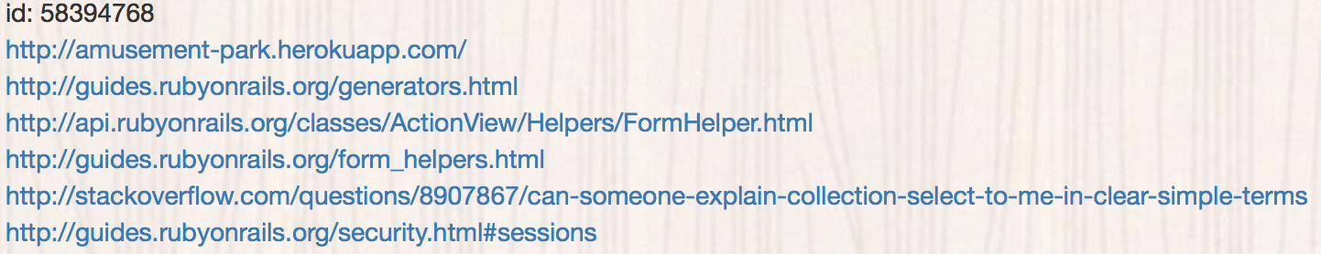
What was achieved in our project?
Aggregated results of clickable links
Notes:
And finally this is the aggregated result of clickable links.

Slide 20

Where our project meets the goals?
Yes!
Is just we can have the further improvement based on the additional user requirements.
Notes:
Where our project meets the goals? Yes! Is just we can have the further improvements upon our projects to do more better in the future.

Slide 21
What were our additional requirements?
Added the sequential number of every README file extracted
Make the project name as the clickable hyperlink
Make the system compatible to all the devices by using the bootstrap
Adjustment of software user interface design
System deployment to web server
Hangyue Xu
Notes:
However, we have been given extra requirements from time-to-time according to our supervisor to make our system much more useful and user-friendly. Here are the additional requirements that we have gathered in the meantime during every meeting.
For my part, one of the additional requirements that I was handling is added the sequential number of every README file extracted. So that the user can get to know easily how many README being extracted.
Next is the make the project name as the clickable hyperlink. The project name will direct to the project repository in a new tab.
Next is the make the system compatible to all devices by using the bootstrap. We have implemented the bootstrap in our front-end web framework so that users can access our system through our domain provided at any place and any devices.
Next is the adjustment of software user interface. We have improved our system from time-to-time in order to become user-friendly and easy to understand.
Next is the system deployment to web server. We have to deploy our system to the web server by using corresponding web services.

Slide 22
What were our additional requirements?
Make the selected URL as the clickable hyperlink
Extracts the clickable picture URL from the README file
Calculation the total of empty files
Aggregate all the extracted section heading in a table
Fetching and presenting the result in dynamic form
System deployment to web server
I-Sheng Chris Wang
Notes:
For my project mate, he did make the selected URL as the clickable hyperlink. Users can check what are the URL been extracted from the README file.
Second thing he has done is aggregating all the extracted section heading in a table. There is a table that shows all the aggregated result of every section heading from the selected README files. If found the same section heading from another README, it will accumulate it.
Next is fetching and presenting the result in dynamic form. after the user has clicked the submit button, the result of presenting each README file will be in dynamic form by using AJAX. Once the first README has been fetched, then it will show the result immediately until the end.
Next is Calculation the total of empty files
It will sum up all the empty file if the selected GitHub project does not have the README file.
And he also help for the deployment of web service.

Slide 23
How we build our proposed system?
Notes:
How we build our proposed system? So this come to the heart of our main topic today that we are going to talk about.

Slide 24

How we build our proposed system?
By using waterfall model
Notes:
We have been using the waterfall model in this project.

Slide 25
How we build our proposed system?
Requirements
Gather requirements from the supervisor
Perform literature review
Notes:
In the first stage of the requirement gathering and analysis, we have gathered all the possible requirements from the supervisor that the system to be developed are captured in this phase. So that we can make sure and confirm what are the actual requirements that we are going to develop along this project.

Slide 26
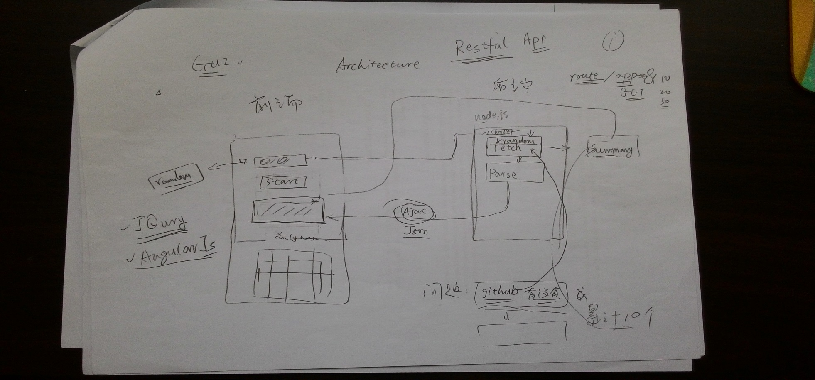
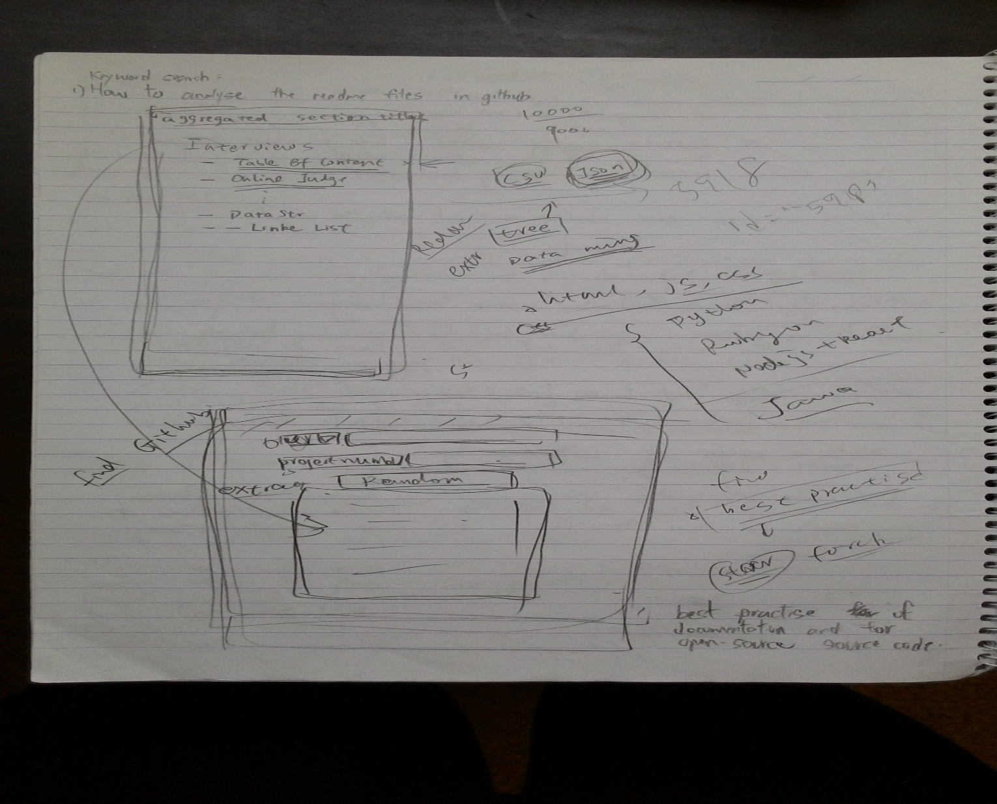
How we build our proposed system?
Requirements
System Design
Chosen software development tools
Drawn the draft of proposed system
Notes:
For the second stage of the system design, is like we have drawn the draft of what shall the system look like in order we have an overall idea on how we start to develop our project. So this is our draft at the very beginning before we proceed to the implementation stage. Furthermore, we may also decide what software tools and programming languages that we are going to use.

Slide 27
How we build our proposed system?
Requirements
System Design
Implementation
Created own README file
Functions created
Connected to GitHub API
Developed user interface design
Notes:
In this implementation stage, we have first tried to create our own README file that contained the section heading, clickable URLs and clickable pictures of URL. And then we created the method for that relevant information to test whether we can extract the result that we want. Secondly, we have tried to connect to the GitHub.com through the GitHub API, so that we can fetch the projects from the GitHub and analyse the README file. After that, we have started to develop our user interface to show the aggregated result based on the user input. We have also implemented those additional requirements in this stage from time-to-time.

Slide 28
How we build our proposed system?
Requirements
System Design
Implementation
Performed the testing
Deployed to web service
Verification
Notes:
In the verification stage, we have performed the testing when there is a major change of our system. For example, after I have finished developing the URLs extraction, I will let my project mate to test whether all the URLs have been selected correctly to ensure that they are error-free and fully meet the requirements. We have also tried to deploy to the web service to test our program when every time we have accomplished some major changes. This is because it can let other users to access to our program at anywhere and any devices.

Slide 29
Integration testing
No | Test Case Objective | Test Case description | Expected Result | Pass/Fail
1 | Check the interface link between the login module | Enter GitHub login credentials. Username and password of the GitHub. | Able to login successfully | Pass
2 | Check the result extracting from the GitHub | User input value and click the submit button. | Able to link with the GitHub API | Pass
3 |  |  | Able to extract the project ID | Pass
4 |  |  | Able to extract the project name | Pass
5 |  |  | Able to extract URL from README | Pass
6 |  |  | Able to extract picture URL from README | Pass
7 |  |  | Able to extract section heading from README | Pass
8 | Check the fetching process | User input value and click the submit button | The console/back-end should show the fetching process of the README file. | Pass

Slide 30
System testing
No | Test Data | Expected Result | Actual Result | Pass/Fail
1 | Positive integer | Able to show the result in table form (Each project) | Same as planned | Pass
2 |  | Able to fetch README from GitHub | Same as planned | Pass
3 |  | The number of list should match with the user input data | Same as planned | Pass
4 |  | Project Name should have | Same as planned | Pass
5 |  | README URL should have | Same as planned | Pass
6 |  | README picture URL should have | Same as planned | Pass
7 |  | Section heading should have | Same as planned | Pass
8 |  | Able to show the result in table form (Title extracted) | Same as planned | Pass
9 |  | Able to sum up correctly for all the section heading | Same as planned | Pass
10 |  | Able to show the number of empty file | Same as planned | Pass
11 |  | The project name should be in hyperlink form. It should be able to open a new page and should the corresponding project | Same as planned | Pass
12 |  | The URL should be in hyperlink form. It should be able to show the description about extracted URL from the README file. | Same as planned | Pass
13 | Zero | Nothing will happen | Same as planned | Pass
14 | Any negative integer | Restricted user key in | Same as planned | Pass
15 | Non-numeric value | Prompt user error | Same as planned | Pass
16 | Decimal number | Nothing will happen | Same as planned | Pass

Slide 31
How we build our proposed system?
Requirements
System Design
Implementation
Undertaken the routine maintenance of the proposed system
Verification
Maintenance
Notes:
And for the last stage, is the maintenance stage. This is the final phase of the waterfall model, in which the completed software product is handed over to the client after performed various testing. After the software has been deployed on the client site, then we have undertaken the routine maintenance activities on our web services.

Slide 32
How we build our proposed system?
Requirements
System Design
Implementation
Verification
Maintenance
Notes:
Undoubtedly, we used this waterfall model simply because this model is simple and easy to understand and use. It is easy to manage due to each phase has specific deliverables and a review process. Also, it works well for the smaller projects where requirements are very well understood.

Slide 33




Programming languages chosen
Programming language used/chosen:
python
HTML
CSS
JavaScript
Notes:
For the next part, I would like to talk about the programming languages that we have developed along this project. We have been using the python to develop our project. At the first place around week 2 or 3, we were still using the Java to develop our system, but after we have done a lot of the literature review and the research about our project specification, we found that python is still the suitable programming language to build a web application. Besides that, we have used the HTML along with the CSS and JavaScript to build our software interface design.

Slide 34

What choose python?

Slide 35
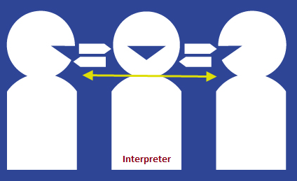
What choose python?
Interpreter
Java needs a complier whereas python does not need.
Notes:
The first reason that we have chosen python is the interpreter:
Java needs an interpreter, for example, Java needs a complier to run the code, yet python code can be run directly and there is no need of compiler.

Slide 36
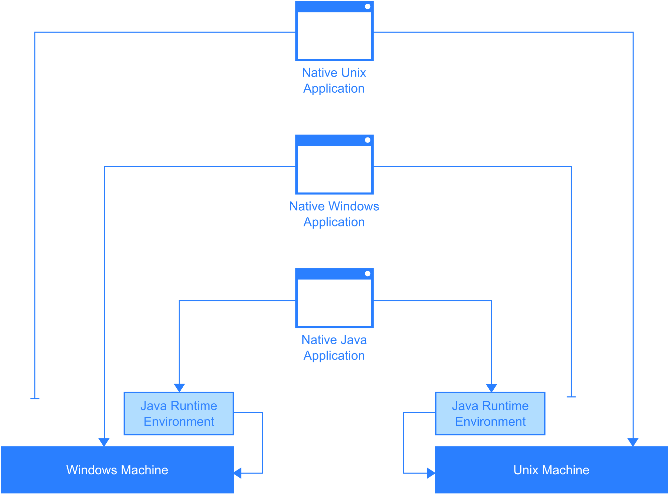
What choose python?
2. Runtime Environment
Java needs some setup environment before running the actual program whereas python does not need.
Notes:
The second reason is the runtime environment:
So is like in order to write java code, some setup environment is needed. For example, by using Netbeans and Eclipse only can run the code. In fact, the code of python can be written on the terminal in Linux and Mac or command prompt in Windows as in web development the HTML and CSS code can be written in a simple text file just like the notepad or sublime.

Slide 37
What choose python?
3. Syntax
Printing hello world in Java
Printing hello world in Python
public class HelloWorld{
public static void main(String[] args)
system.out.println(“Hello World”);}
print “Hello World”
Notes:
The third reason is the syntax:
The python allows programmers to express their concepts in the fewer lines of code compared to Java.
This example show that if we want to print the hello world, we will need to write the following code in Java-
But for python, we only need to write print “Hello World”. Just one line to run a program. Anywhere, most crucially, we found a lot of the information on the website in regard to our project that was using the python. Consequently, we have decided to use python along our project.

Slide 38
What software development tools we have chosen?

Slide 39

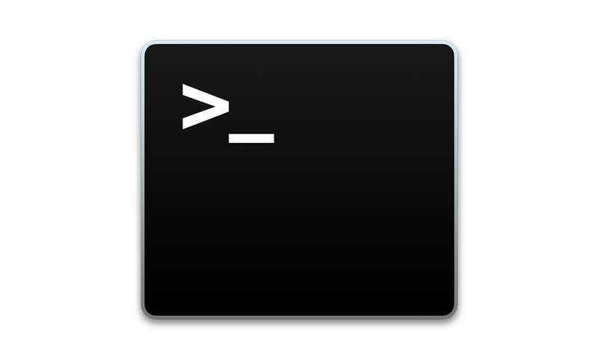
What software development tools we have chosen?
An IDE specifically for the python language.
Registered through the JetBrains Educational pack
Full features are given
1. PyCharm
Simple run to present
Install other third-party applications through Terminal such as Django, Flask, python 3, bootstrap, etc.
2. Terminal
Notes:
This is a command line interface that available in Linux OS. Is like when we just need to run our program instead of coding, we will use this software tool to simple present our progress to our supervisor. Moreover, we have used the Terminal to install other third-party applications that required during the project development, such as Django, flask, python 3, bootstrap, etc.

Slide 40

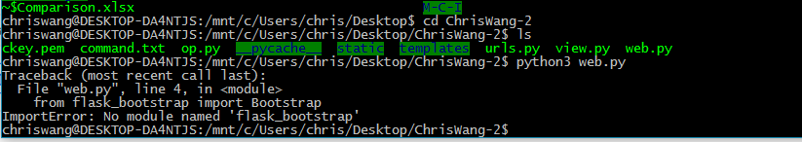

What software development tools we have chosen?
It is Web development microframework
Allow users to deploy the system to web services
3. Flask
Source code and documentation management
4. GitHub
Notes:
this is the web development microframework and is written in Python. It is a web framework that allow us to run the program and display on the website. It was the most popular Python web development framework on GitHub. (Click slide) Without this web framework installed in our PC, this issue will be come out.

Slide 41
What have we learned in this project?

Slide 42


What have we learned in this project?
We only learned when we made mistake.
Encountered problems
Lessons gained
Notes:
We only learned when we made mistake.

Slide 43
What have we learned in this project?
1. Programming Language
Start from nothing to something
Acquired new syntax and other library reference while using Python
2. Setting up the local programming environment
Prerequisites required when compile and run the system -> flask, bootstrap, specific version of python
Notes:
We were start from the zero about its framework structure, the standard library especially its build-in types, data types, functional modules, built-in exceptions, and other libraries reference that we acquired from the beginning of this project.
The second thing we have learned was setting up the local programming environment on our PC. as flask, bootstrap, the specific version of python in order to successfully run the system on the website.

Slide 44

What have we learned in this project?
Difference between python 2 and python 3
Require different web framework while deploying the system to the web service
“print” statement work
Notes:
The reason that we need to specify the specific version of python because these two version will require different web framework while deploying the system to the live. The most obvious different is probably the way the “print” statement work. It is different enough that the same script won’t be able to run on both versions at the same time.

Slide 45

What have we learned in this project?
We have chosen python 3 (3.6.1) because …
It is the latest version of python currently
Nicer and more consistent language
It is on the cutting edge at this moment
Take is as a challenge
Notes:
We have chosen the python 3 framework with the version of 3.6.1 to develop our project as it is the latest version of the python, even though there is very limited third-party module support currently but we would like to take it as a challenge. Although python 2 has its own libraries, but python 3 is a nicer and more consistent language and it is on the cutting edge currently, so all the new features will be implemented in there rather than being added to python 2. However, all the major frameworks are still running on the Python 2 at this moment.

Slide 46




What have we learned in this project?
3. Deployment of web services
Get to know how to deploy the system to the web server
Web hosting service we have tried:
Heroku
Amazon WebService
DigitalOcean
PythonAnywhere
Notes:
The third thing we have learned is the deployment of web services. This is another field that we have spent a lot of time here. Right now we have known how to deploy our system to the web server, like a real website by using the deployment web services. We have being tried for various web hosting service that including Heroku, Amazon Web Service, PythonAnywhere and finally we have chosen the DigitalOcean to deploy our system to the web server, so that anyone can access to our website at anywhere and any devices.

Slide 47
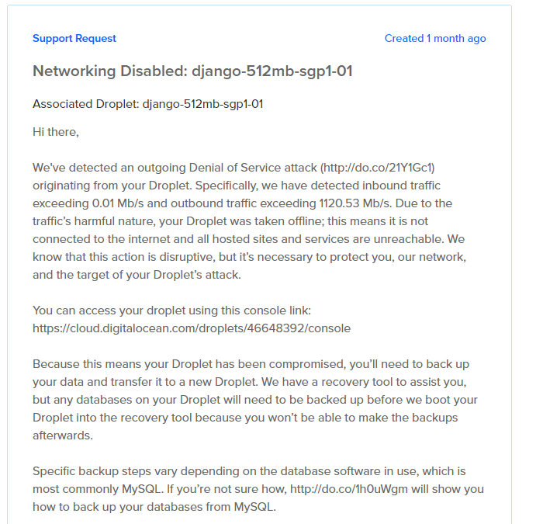
Issue faced after deployed for certain period: outbound traffic data has exceeded the limit required
Notes:
But for sure, we were faced some issue about the networking service termination due to outbound traffic data has exceeded the limit required. Which means it has been overloading, so that the support team of DigitalOcean has been disabled our droplet in order not to prompt the GitHub organisation the suspicious outgoing denial of service attack.

Slide 48
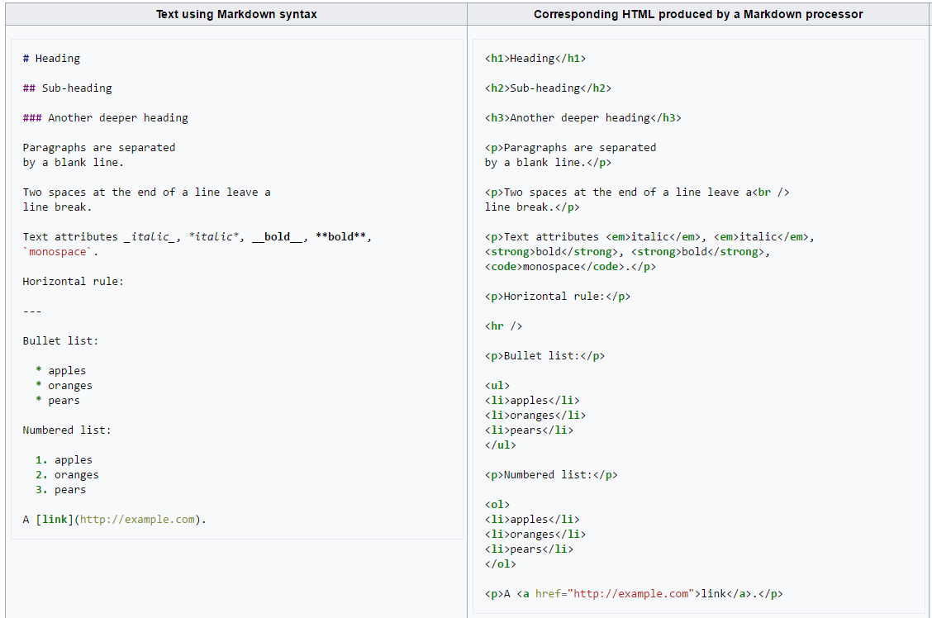
What have we learned in this project?
4. The format of creating the README file
Markdown language is often used
Similar to HTML
Notes:
In the meantime, we have also learned about the format of creating the README file. So basically, most of the time the README file on GitHub is developed using the markdown language.

Slide 49
What have we learned in this project?
Syntax of creating the README file
Section heading
#H1
Links
[text](URL domain)
e.g: [GitHub](http://www.github.com)
Images
![]() or ![][]
Notes:
We also got to know the syntax of creating the REAMDE file as well as how we extract certain information from the README file to analyse it.

Slide 50
Future Development
Fetching and presenting the result in dynamic form
The result will be shown one by one(by using Ajax)
1 6843689 xu5853939?sahsjs 0 5 1
1 8493758 zorrosdfsdf/sdfsdf 6 0 1
1 3578904 wt6fndfgtrgx_rfds 5 10 1
1 1592578 pthonalngaugejesposit 3 0 1
1 5148778 vvdfgdfg 2 1 1
1 3454567 madbsj86454 0 16 1
1 9087698 mciprojetc_Bui 0 1 1
1 3434345 javaprogramming 3 0 1
1 4789965 304gg.comDota 2 0 1
1 2567178 dfsdfsdf 0 1 1
Notes:
Fetching and presenting the result in dynamic form. The result will be shown one by one (by using Ajax)

Slide 51
Future Development
More detailed extraction for section headings
More classification of the section headings (e.g: H1 H2, H3, H4, H5 and H6)
# H1
## H2
### H3
#### H4
##### H5
###### H6
Notes:
More detailed extraction for section headings. More classification of the section headings (e.g: H1, H2, H3, H4, H5 and H6)

Slide 52
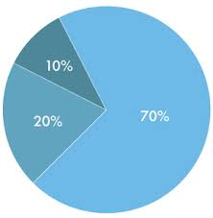
Future Development
Result in percentage
Calculating the content result
Pie Chart of Percentage

Slide 53
Demonstration Time!

Slide 54
End

